Slide 1
Procedural Generation Using Quantum Circuits
Members:
Coaches:
Ghulame Mujtaba Arbi
Bernard Lebeko Poulo
Eric Ndirangu
Coral Featherstone
Ken Nixon
James Wootton (remotely)

Slide 2
Background on Procedural Generation
Procedural Generation of:
Maps
Levels
Puzzles
Stories for games

Slide 3
Procedural Generation Techniques
Seeded strings
Perlin noise
Recursive formula

Slide 4
Why use quantum
Scalability
Speed up
Randomess
Reduction in computational complexity

Slide 5


Prototype: Vector graphics (SVG)

Slide 6
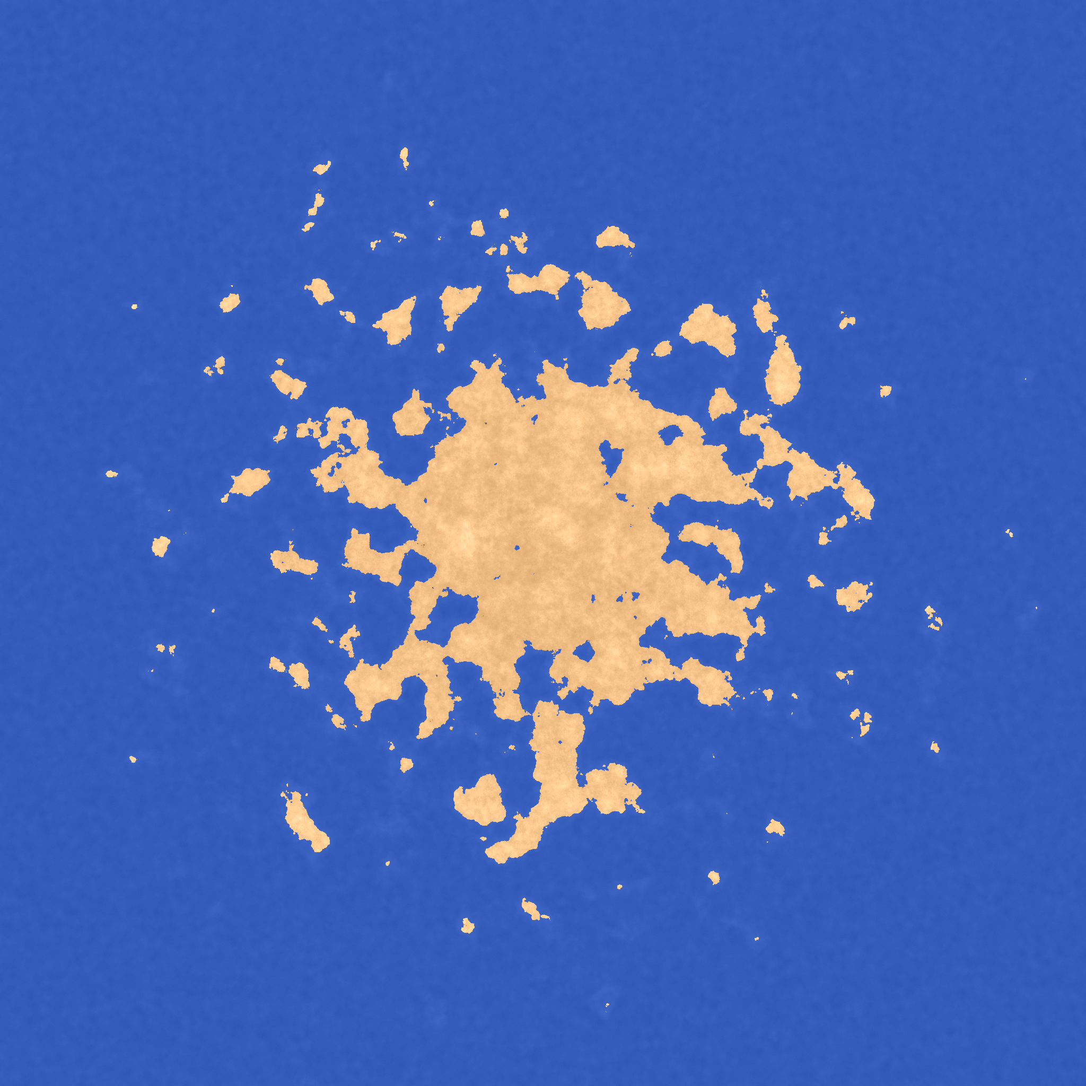
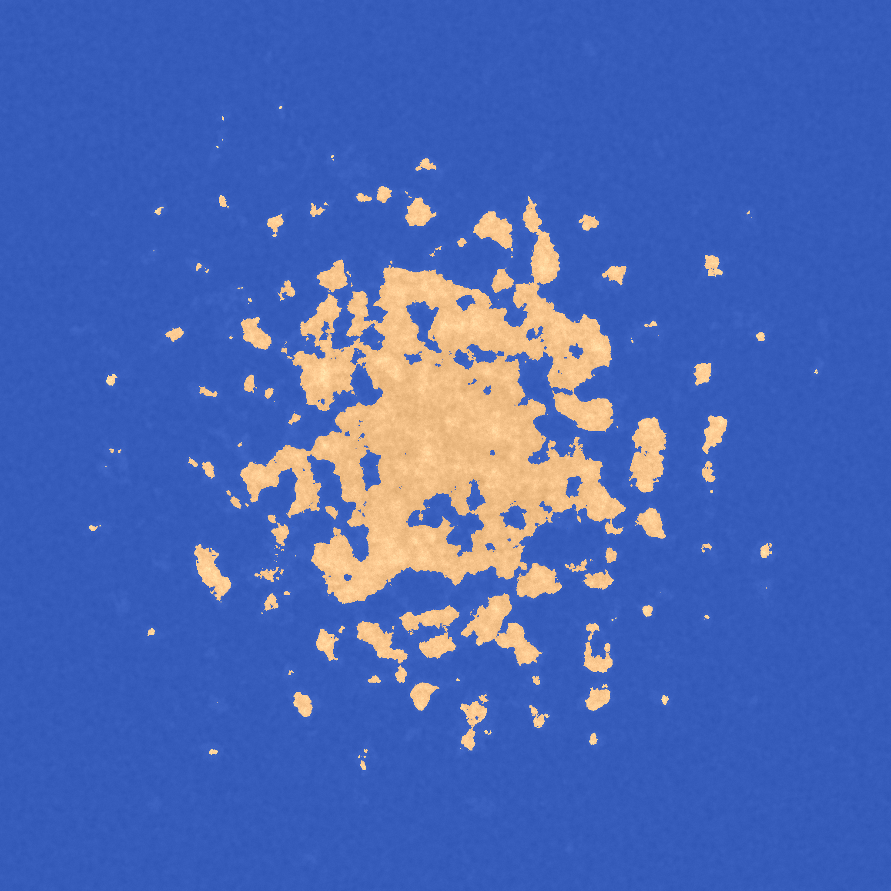
Prototype: Raster Graphics and Perlin noise

Slide 7
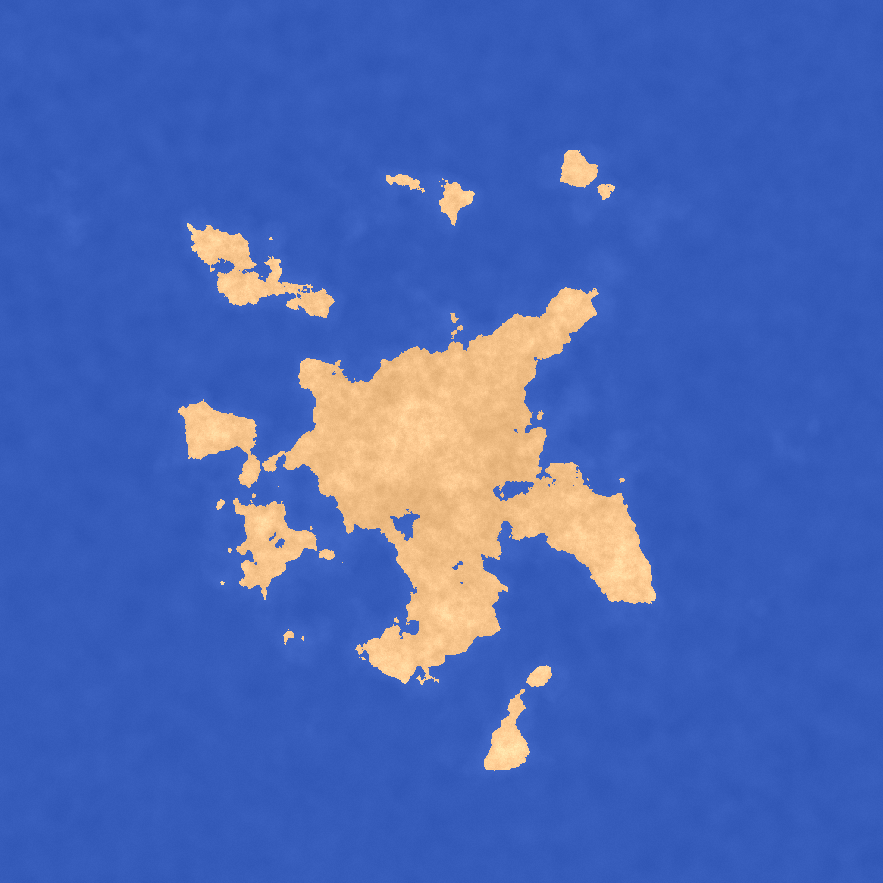
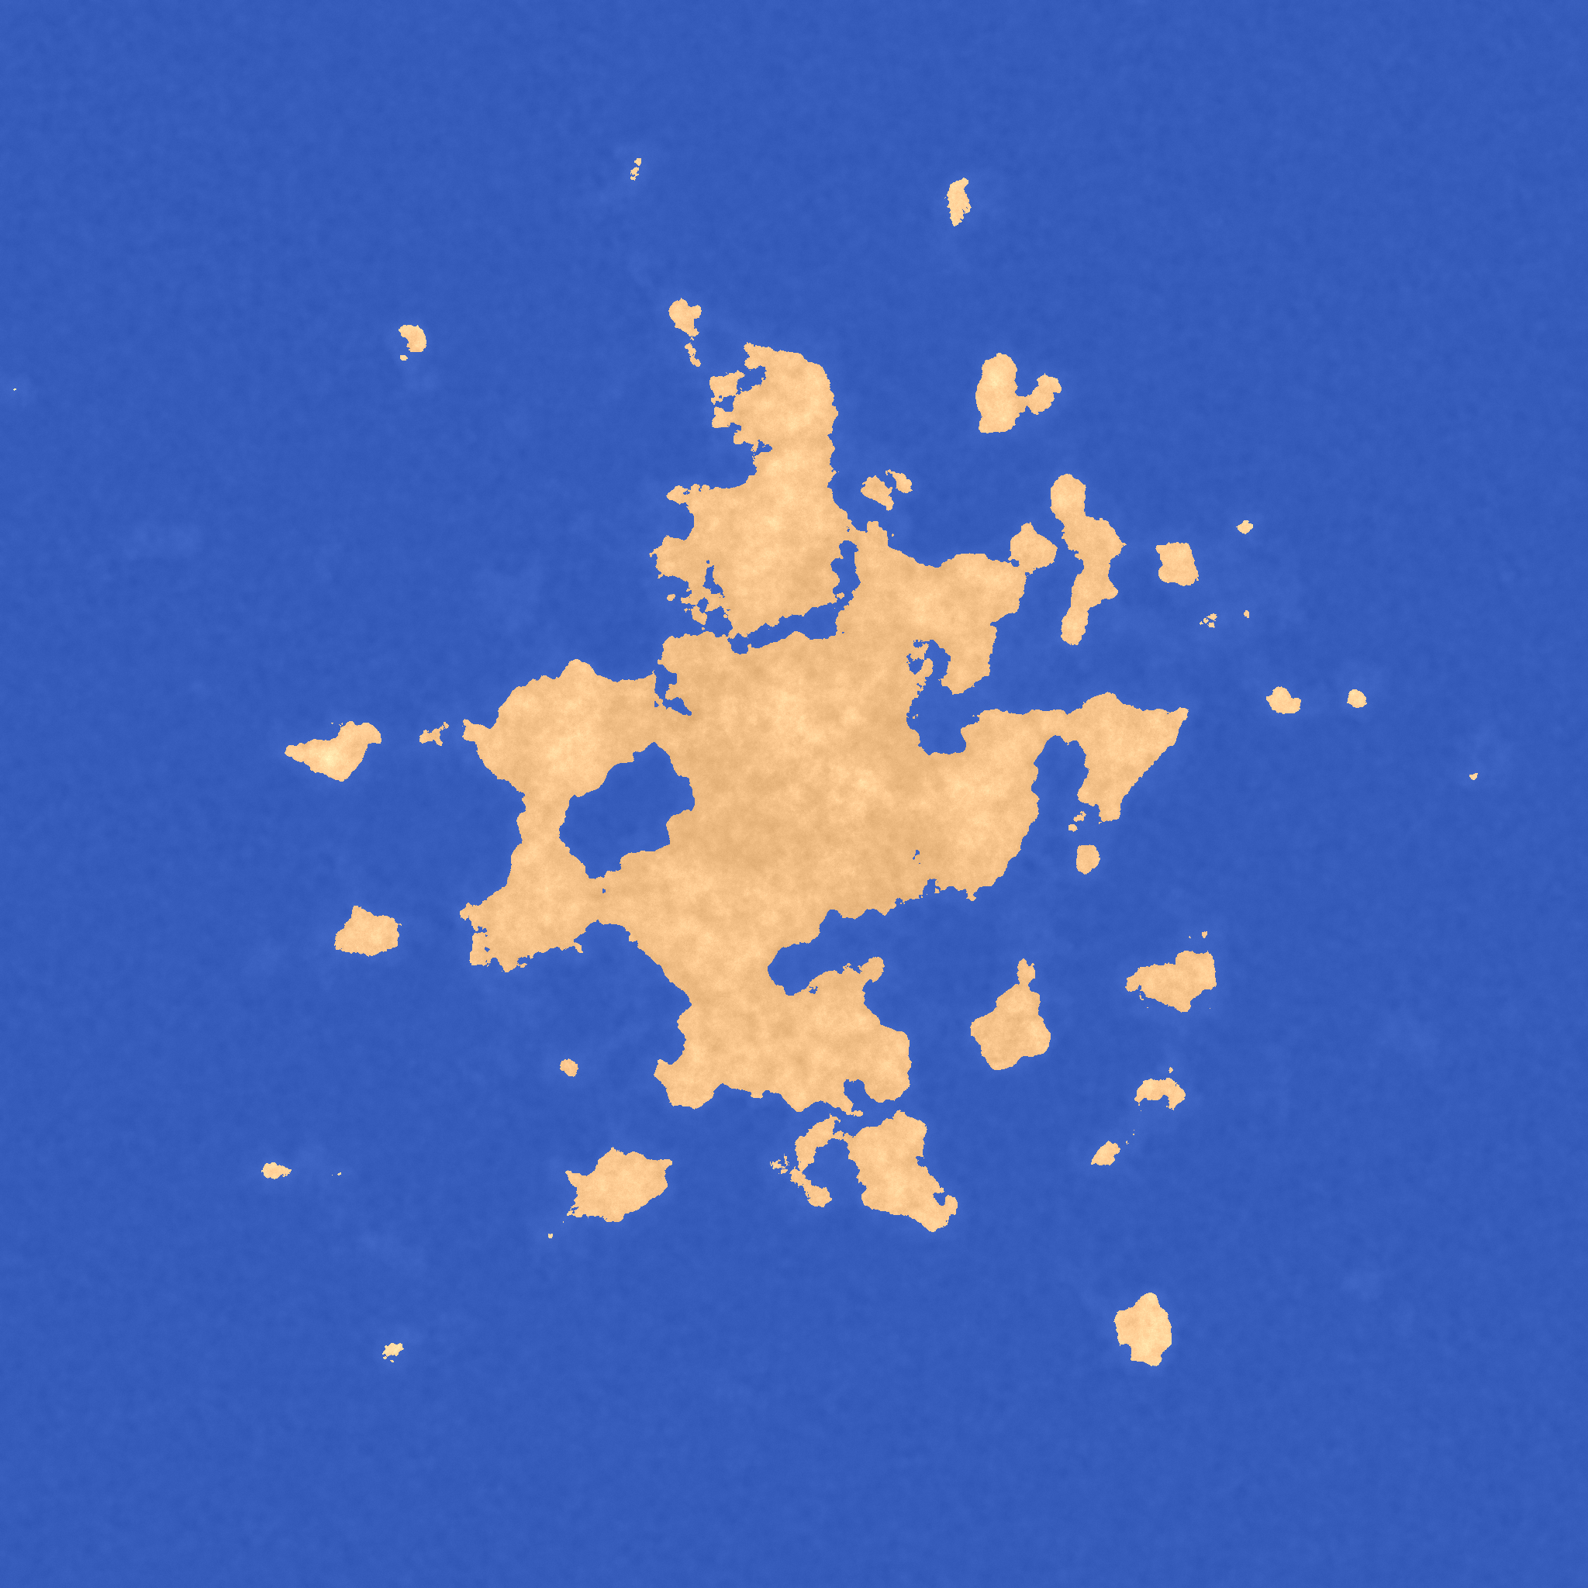
Prototype: Raster Graphics and Perlin noise

Slide 8
Conclusion
Possible improvements:
Landscapes
Using more qubits and other gate types

Slide 9
Thanks

